Slide 1

School Zones and Chicago Crime Rates
Laura Schmidt, David Tabor, Anthony Ruggeri

Slide 2
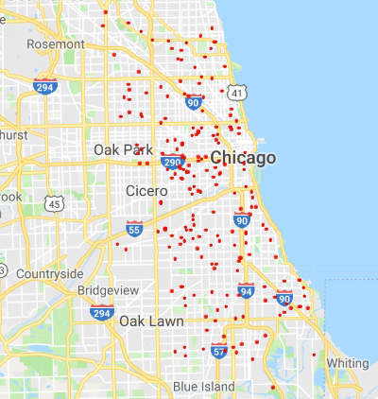
Scope
661 CPS schools.
Trimmed down to 208 for our purposes.
124 HS, 84 ES.
Excluded schools that are not K-8 or 9-12.
Crime data throughout Chicago for even years 2008-2018.

Slide 3
Background
Investigating the relationship between closeness to schools and crime rates.
School zone- 1000 ft between 7 AM- 6 PM on any day school is in session.
Certain crimes within a school zones receive stiffer penalties.
Do the increased sentences for certain crimes within school zones deter these crimes?
Do certain crimes peak at different times in the year?
Have any crimes become more frequent/less frequent over time with the advent of safe passage zones?
In general, we expect crime rates to be lower within school zones
School zones may overlap, so ES and HS area crimes may not be independent.
By making small radii around schools, we hope to limit this effect.

Slide 4
Data Sources
CPD reported crimes 2008-present
2008, 2010, 2012, 2014, 2016, 2018
https://data.cityofchicago.org/
Google Maps API
To find school locations and proximity of a crime to the nearest school.
Chicago Schools API
https://dev.socrata.com/foundry/data.opendatanetwork.com/atj2-dnzr
CPS.edu blog
For info on safe passage zones.
Passed in 2009 to ensure safe routes to/from school for children.
https://blog.cps.edu/2018/08/30/safe-passage-how-it-works-the-impact-and-expansion/

Slide 5
School Data Cleanup
Collected data from API and saved to csv files.
Dropped unnecessary school columns, keeping school name, location, grade levels and community.
Dropped schools that did not meet requirements of K-8 and 9-12.

Slide 6
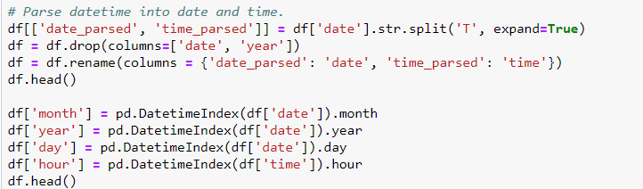
Crime Data Cleanup
Collected data from API and saved to csv files.
Split date into month, day, and time.
Created separate file to read in all csv files.
Dropped data lines with missing data.
Changed column names to allow for seamless joining with schools data.
Dropped crimes that did not include theft, battery, narcotics, weapons violations, and criminal damage.

Slide 7
Data Analysis
Two files: one with crime data, one with school data.
Created new dataframe for each year, only including type of crime, year, and school ID columns.
Created map of selected schools.
Used lat/longs in school and crime data to determine the closest school to each crime.
Found closest school to each crime and distance to determine if its in a school zone or not.
Created visualizations to display trends in data.

Slide 8
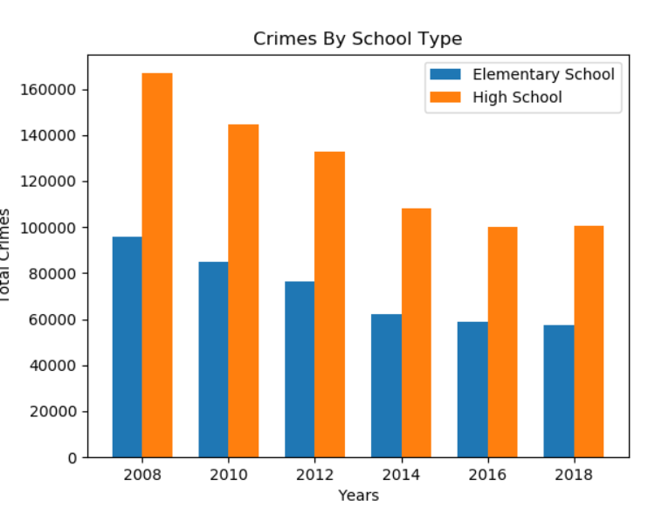
Crimes by School Type

Slide 9
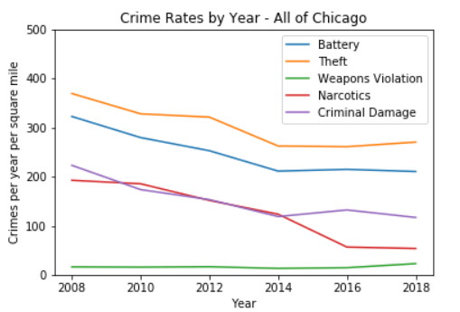
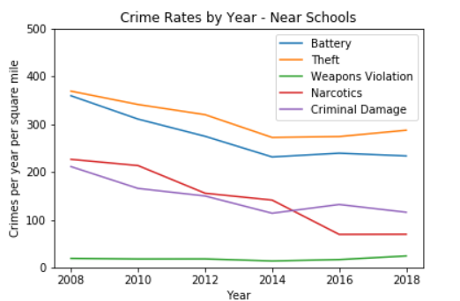
Crime Rates in School Zones vs City-wide

Slide 10
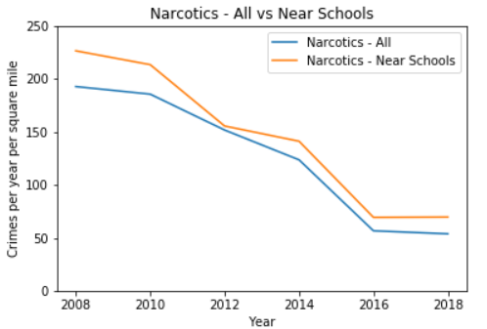

T test
Two sided independent t test
Summed crime counts for selected crime categories for each year and took averages.
Wanted to see if crime rates are significantly different in school zones vs not.
P =0.49, no significant difference between narcotics crimes in school zones vs not.

Slide 11
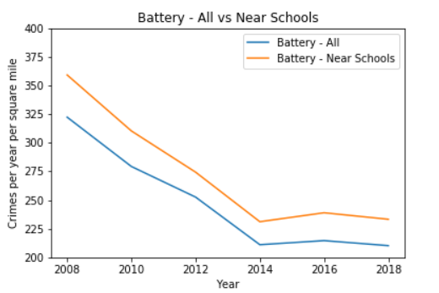
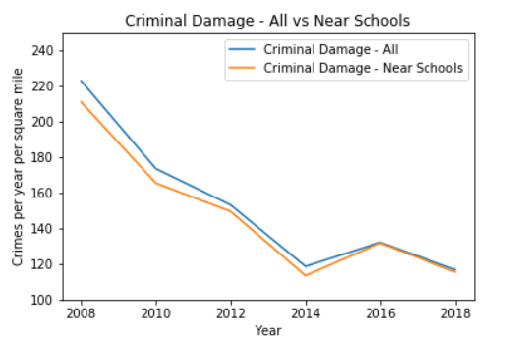
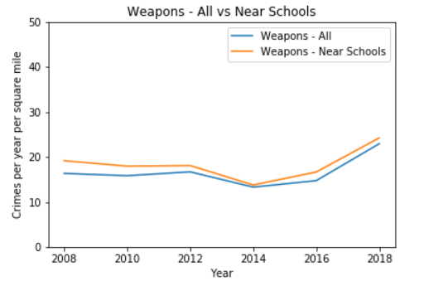
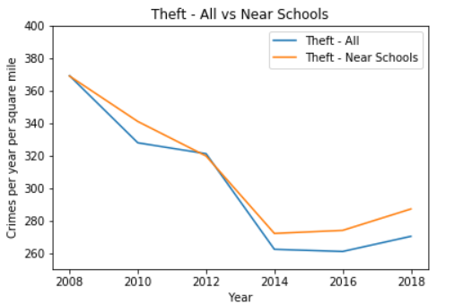

Slide 12
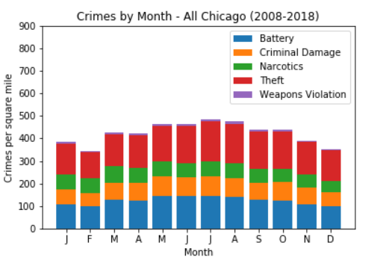
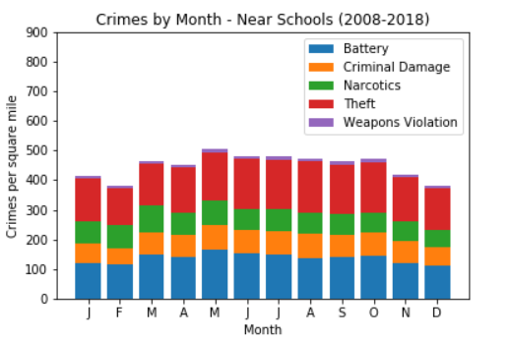
Seasonality

Slide 13
Conclusions
Stiffer penalties do not appear to deter crimes.
Crimes still occur in school zones, even with stiffer penalties.
However, based on the data, crime in school zones and the entire city is trending down.
Things to consider:
Medical marijuana program put into effect Jan. 1, 2014.
Narcotics crimes is only category only to trend down at this point.
Concealed carry introduced in IL in July 2013.
No apparent effect on weapons violations.
Safe passage program has been ramping up since inception.
35 school in 2009 to 159 schools in 2018.
1350 workers on routes in 2018.

Slide 14
If we had more time, more money, and no full time jobs…
Wanted to plot crimes along safe passage routes to see if the routes are effective.
Would get population densities of each school zone and incorporate this into comparison to see if closeness of neighbors influences crime rates of certain categories.
Wanted to lay a heatmap on top of schools to visualize but sheer number of crimes made it hard to infer anything.
Could’ve divided by number of schools of each type to eliminate disparity in HS and ES totals.
To continue exploring: do these safe passages matter?
City claims 9% reduction in crime from 2017 to 2018

